Slide 1


APSSDC
IoT with Raspberry Pi

Slide 2
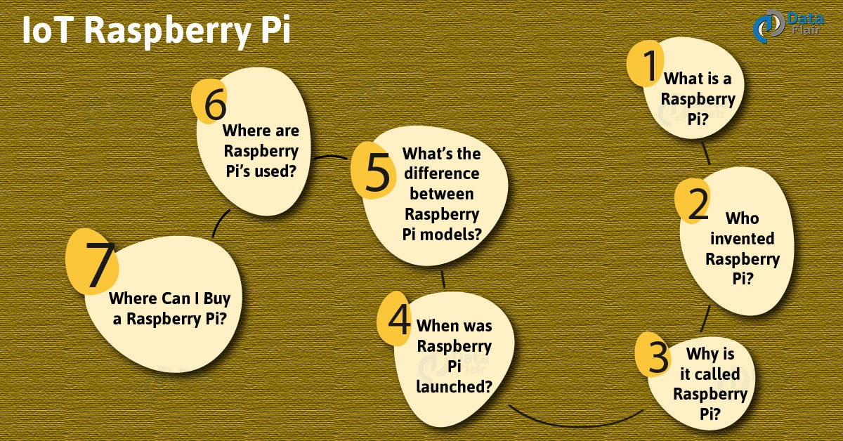

Slide 3
What is a Raspberry Pi?
Official site: www.raspberrypi.org
The Raspberry Pi is a low cost, credit-card sized computer that plugs into a computer monitor or TV, and uses a standard keyboard and mouse.
It costs between Rs 750 and Rs 4000.
The Pi changed into what initially was meant to be a microcomputer to teach kids coding.

Slide 4
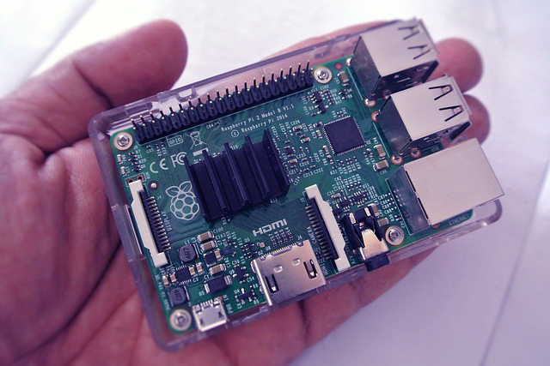

Slide 5
Who Invented IoT Raspberry Pi?
The Raspberry Pi Foundation was formed in the year 2008
So they came up with a low-cost computer as a solution to inspire children and make it more accessible.

Slide 6

Why is it called Raspberry Pi
The “Raspberry” name is a homage to computer companies in early times that were being named after a fruit, like Apple, Apricot Computers, Tangerine Computer Systems. The idea to make a small computer to run only the Python programming language is where the “Pi” derives from.

Slide 7
When was IoT Raspberry Pi launched?
The first Raspberry Pi unit which was available commercially was launched on February 19, 2012. This version featured 256MB of RAM, could run on Linux–based desktop operating systems, had one USB port, and no Ethernet port. This was named the Model A.

Slide 8
What’s the Difference Between Raspberry Pi Models?
IoT Raspberry Pi models can be confusing because there are so many of them and there are two levels to the naming system. The “generation” of the model, represent by Pi 1, Pi 2, and Pi 3 where Pi 1 is for models between 2012-14, Pi 2 is 2015 models, and Pi 3 is 2016 models. So 3 is the most recent which is better than 2, which is better than 1.
The power and features indicate by model A, A+, B, and B+. It’s not like grades though, A is lower than B.

Slide 9
Where is IoT Raspberry Pi’s used
IoT Raspberry Pi can be used in a wide variety of tasks.
It’s ideal and best suitable for projects.
Teach kids (or yourself) the way to code.
Use it as a desktop pc.
Make your very own retro gaming console.
You can make an FM radio or a global clock.

Slide 10
Where Can I Buy a Raspberry Pi
IoT Raspberry Pi can be brought through three official partners, but there are also third-party sellers in the market like Amazon, eBay, or other retail stores. Here are the official stores:
RS online
Element 14
Think Allied

Slide 11
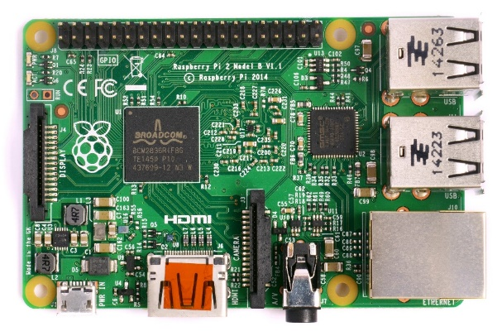
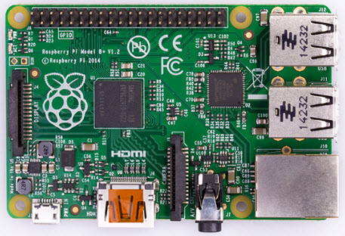
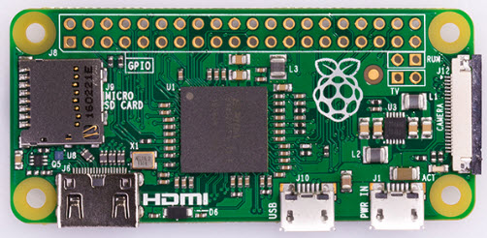
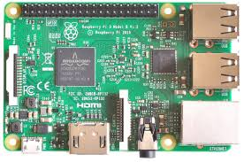
Raspberry Pi Models

Slide 12
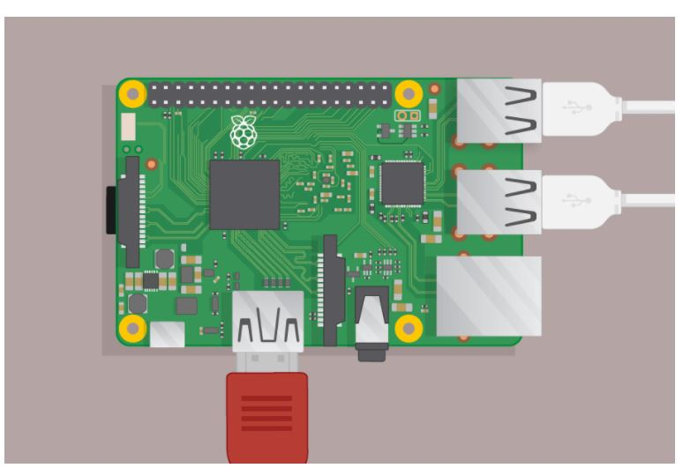
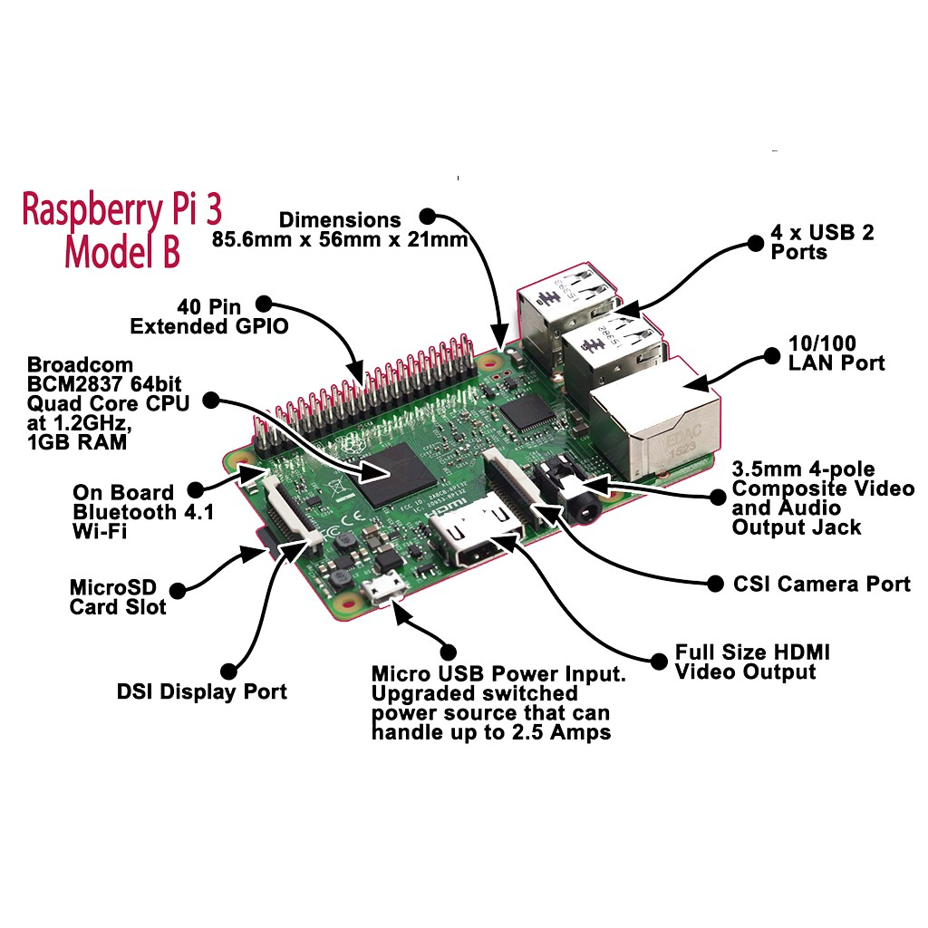
Raspberry Pi 3 Model B

Slide 13
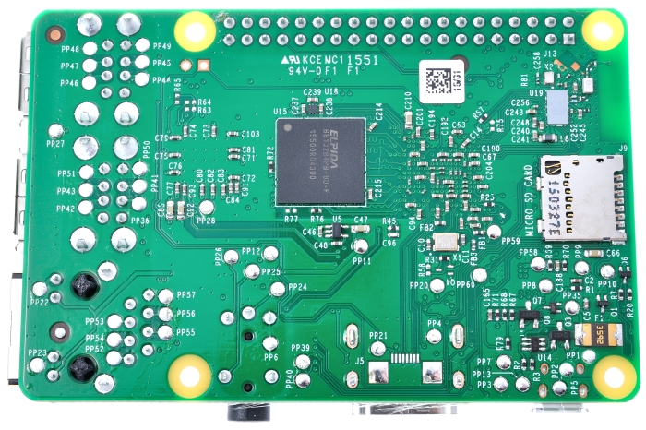
Raspberry Pi 3 Model B
BCM43438 WiFi/BT chip

Slide 14
Specifications
SoC: Broadcom BCM2837
CPU: 4× ARM Cortex-A53, 1.2GHz
GPU: Broadcom Video Core IV
RAM: 1GB LPDDR2 (900 MHz)
Networking: 10/100 Ethernet, 2.4GHz 802.11n wireless
Bluetooth: Bluetooth 4.1 Classic, Bluetooth Low Energy Storage: microSD
GPIO: 40-pin header
Ports: HDMI, 3.5mm analogue audio-video jack, 4× USB 2.0, Ethernet, Camera Serial Interface (CSI), Display Serial Interface (DSI)

Slide 15
Raspberry Pi Networking

Slide 16
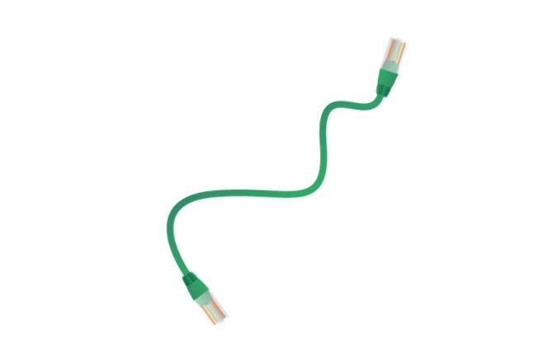
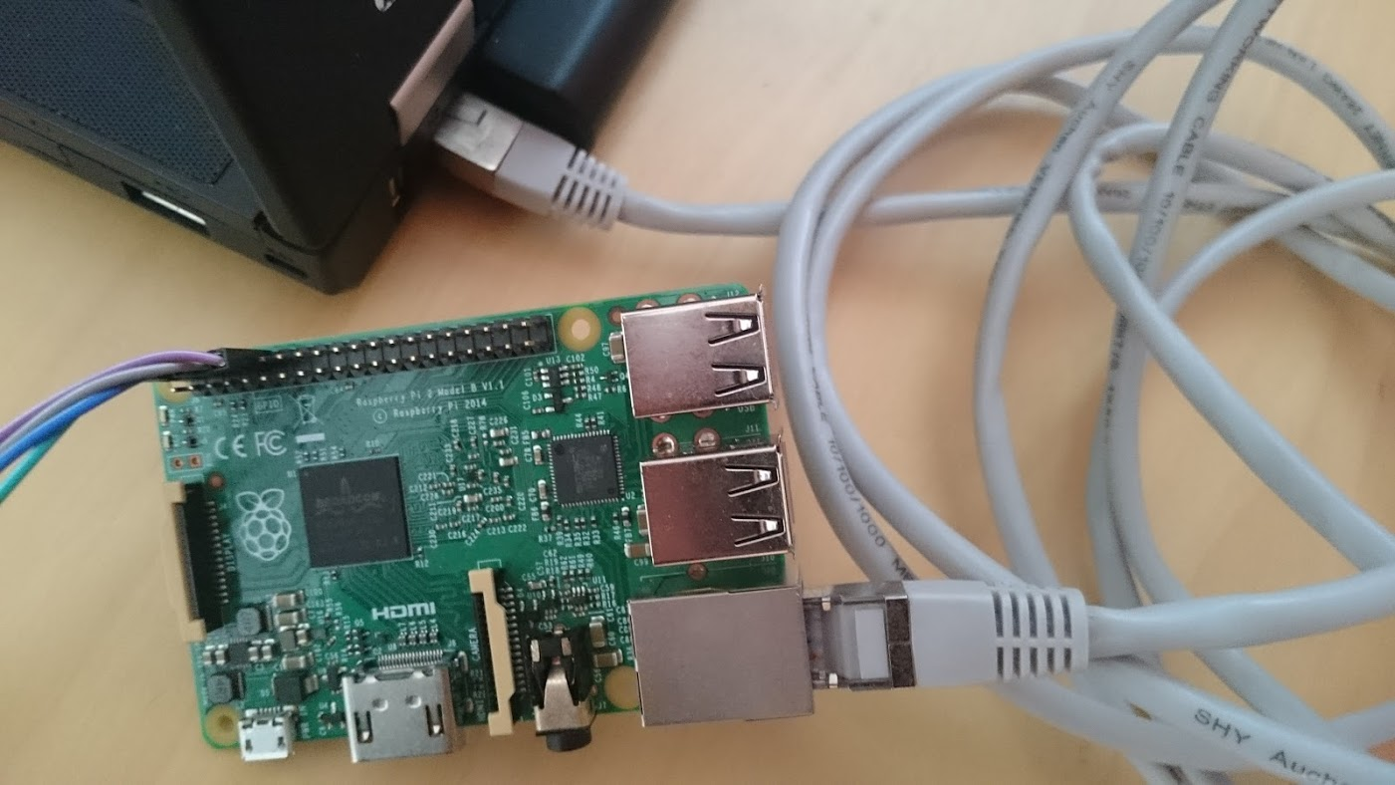
Raspberry Pi Networking-Via Ethernet

Slide 17

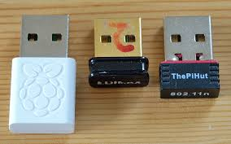
Raspberry Pi Networking-Via WiFi
Raspberry Pi-3 Built in WiFi

Slide 18
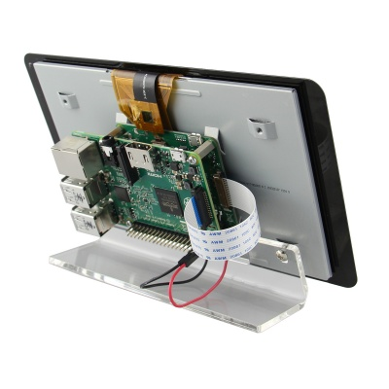
DSI(Display Serial Interface) Port
The Raspberry Pi connector S2 is a display serial interface (DSI) for connecting a liquid crystal display (LCD) panel using a 15-pin ribbon cable.
The mobile industry processor interface (MIPI) inside the Broadcom BCM2837 IC feeds graphics data directly to the display panel through this connector

Slide 19
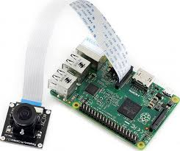
CSI(Camera Serial Interface) Port
The Raspberry Pi has a Mobile Industry Processor Interface (MIPI) Camera Serial Interface Type 2 (CSI-2), which facilitates the connection of a small camera to the main Broadcom BCM2835 processor

Slide 20
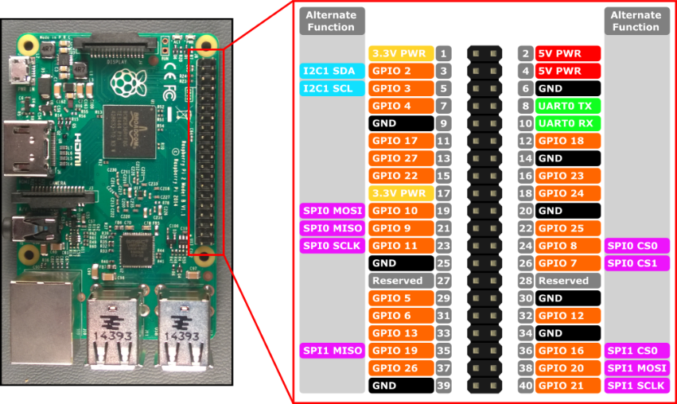
GPIO Pins

Slide 21
Equipment Needed to set up Raspberry Pi

Slide 22
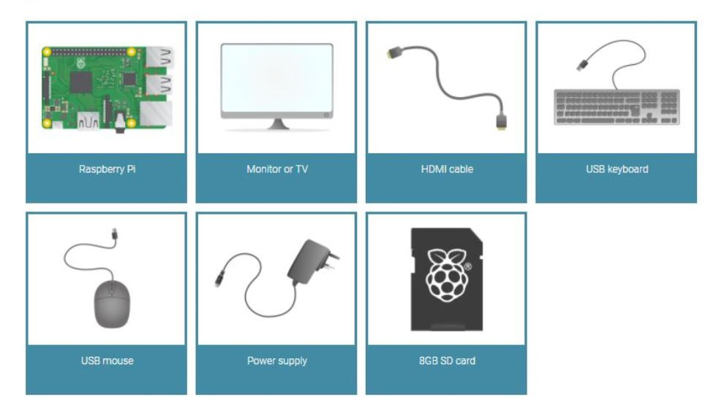
Equipment Needed..
A Monitor with VGA/HDMI cable
Power supply
USB Keyboard and Mouse
SD Card

Slide 23
Setup..

Slide 24
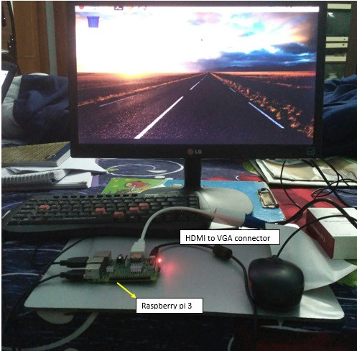
Hardware Setup..

Slide 25
Software setup..
Select the Operating System
Download the Operating system
Format SD card
Burn(Flash) the SD card

Slide 26
Operating system
NOOBS
Raspbian
Raspberry Pi Desktop
Thirty Party operating system-Ubuntu Mate
-Windows IoT core
-PINET
-RISC OS

Slide 27
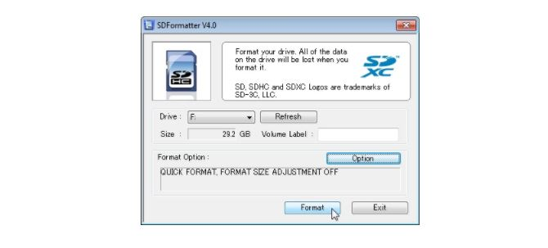
Format SD card…
Sdcard.org->Download SD card formatter
Install the software

Slide 28
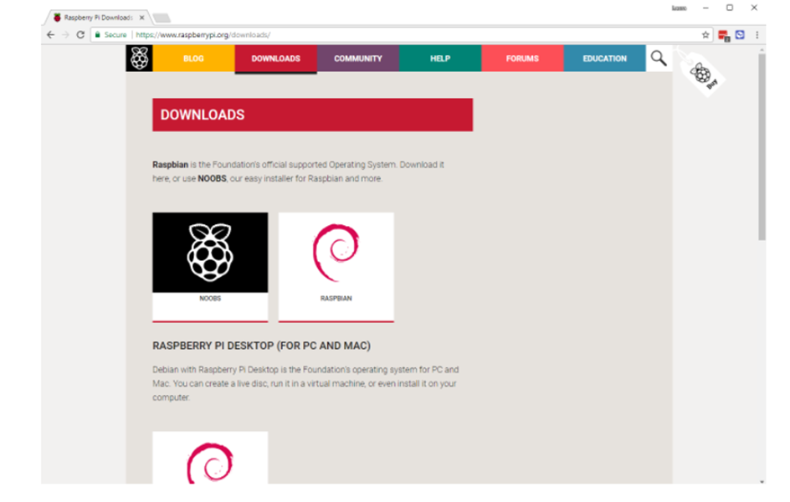
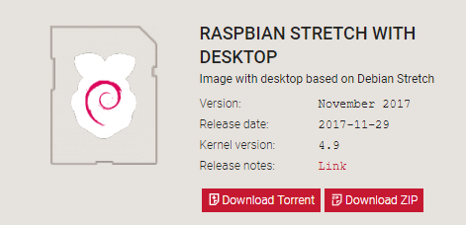
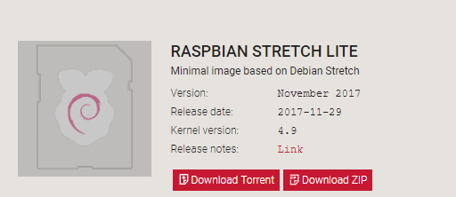
RASPBIAN
RASPBIAN STRETCH WITH DESKTOP
RASPBIAN STRETCH LITE

Slide 29
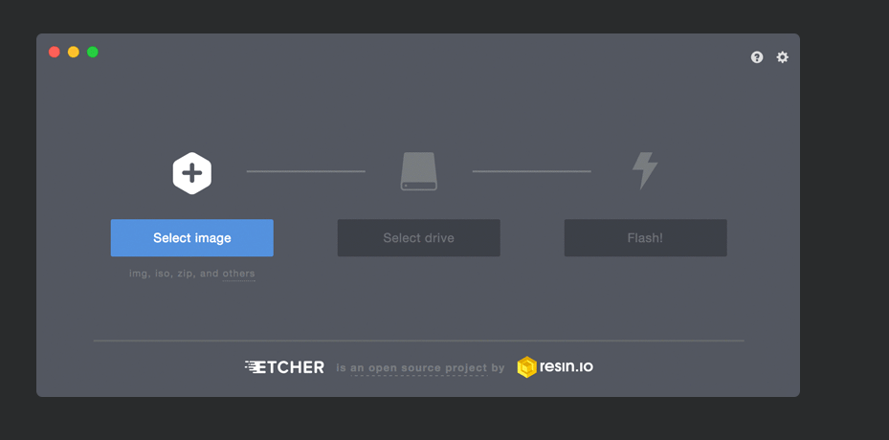
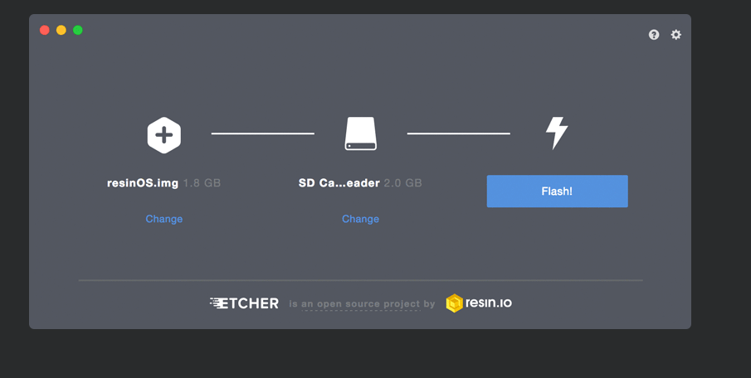
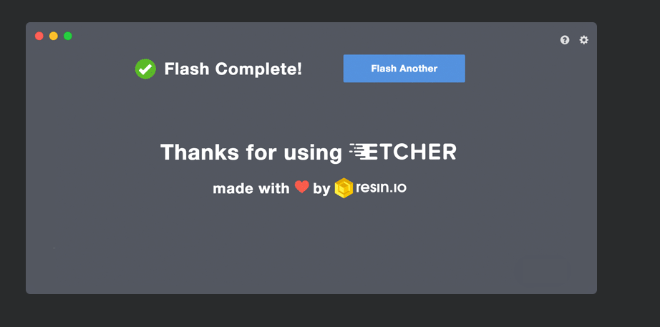
BURN(FLASH) O.S
ETCHER-Software(etcher.io)

Slide 30


